Slide 1


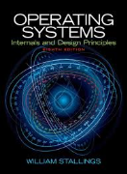
Welcome to
CS 345 Operating Systems
Operating Systems (05)

Slide 2
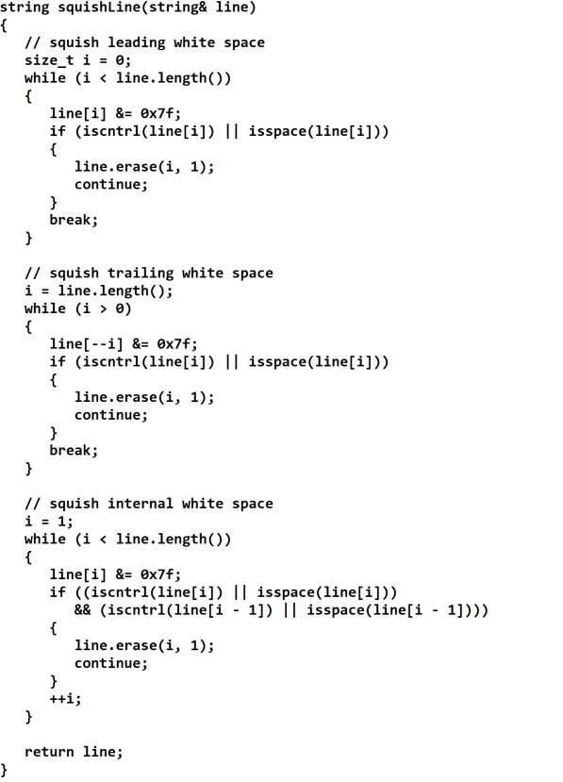
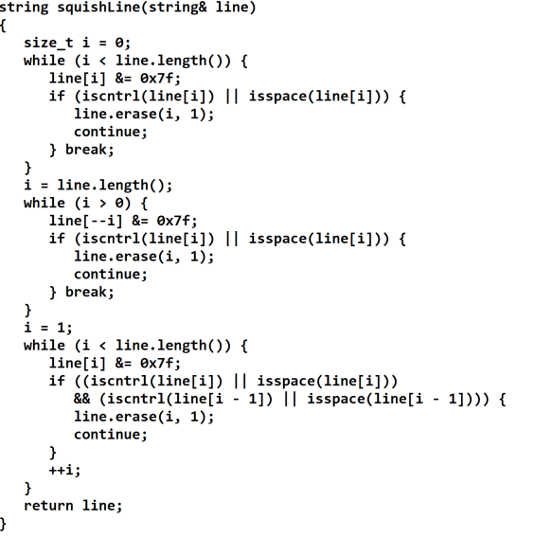
Tip #6: Chunking
A primary method that the brain uses to help it absorb more information is called 'chunking'.
One chunk is a recognizable piece of information that be fitted into one of the 'slots' in short-term memory.
Chunking makes block structured languages like C/C++ natural to use.
The program is a single chunk, which is divided and subdivided into smaller and smaller chunks, each visibly and logically distinguishable.
Lay out code in chunks
Groups of statements which together perform an identifiable act, should be chunked.
Items which are close together form a visual chunk and have an implied association.
Vertical white space (form feeds and blank lines) can be used not only to separate chunks but also to show relationships between chunks.
By recognizing chunks and making them stand out, code can be made more readable which means more maintainable.
Un-chunked List:
Bread
Ice cream
Milk
Tomatoes
Eggs
Butter
Apples
English muffins
Frozen vegetables
Lettuce
Cream
Bananas
Chunked List:
Frozen Foods Bakery
Ice cream Bread
Frozen vegetables Bagels
Dairy Fruits / Vegetables
Milk Tomatoes
Eggs Apples
Butter Lettuce
Cream Bananas
Notes:
Consider newspapers and magazines articles. The heading is big and visible. The article itself tends to be fairly brief. Paragraphs are small. If the article is more than a few lines long, it is broken up with sub headings, out-of-context quotes, pictures, etc. It is delimited with blank and solid lines. Everything possible is done to break it up and give the brain time to stop and take in each piece of the message.

Slide 3
Operating Systems Overview
Chapter 2

Slide 4
Brief Look at the Evolution of OS
In the beginning…
There were no operating systems,
No programming languages or compilers,
No mice and no windows,
and the earth was without form, and void; and darkness was upon the face of the deep.
What would industry be like with an operating system?
"Your computer would stop working because xxxx is the operating system, the software that makes it tick and provides a platform for programs, like your web browser, to run on. Without an operating system your laptop is just a box of bits that do not know how to communicate with one another, or you."
"An operating system is the most important software that runs on a computer. It manages the computer's memory and processes, as well as all of its software and hardware. It also allows you to communicate with the computer without knowing how to speak the computer's language."
"Today's operating systems are conceptually upside-down. They developed the hard way, gradually struggling upwards from the machinery (processors, memory, disks and displays) toward the user. In the future, operating systems and information management tools will grow top-down."

Slide 5
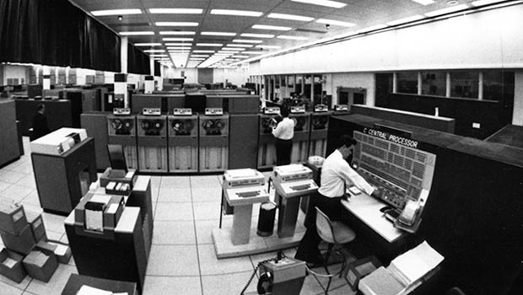
The OS Evolution
OS Complexity
BINAC
ENIAC
UNIVAC
IBM 701
UNIVAC 1103A
FORTRAN
IBM 7090
Burroughs B5000
DEC PDP-1
IBM System/360
EDSAC and EDVAC
Transistor
1940
1950
1960
1970
1980
1990
2000
2010
2020
Notes:
The "system". IBM set the company on the 360.
IBM bet the company on this one. It created a line of five computers, all compatible, that gave users a migration path as their computing needs grew. It included the largest assortment of simulators and emulators ever assembled for backward compatibility. Card readers, tape drives, printers, and memory devices were redesigned to make them faster (for instance, the System/360 Model 1403 Chain Printer printed 1,100 lines of text per minute).
R&D for the project cost over $1 billion dollars. Within six months after its announcement, IBM booked orders for System/360s that totaled more than three times IBM’s entire annual income. The bet paid off big time.
System/360 operating system goal: deliver one operating system for the entire line of computers.
The reality: It proved difficult to create a system that would satisfy users with varying degrees of sophistication. It also didn’t seem fair to burden smaller machines with heavy-duty operating systems. A family of operating systems emerged:
PCP/360 — sequential job system
MFT: multiple job system, fixed number of tasks. The system memory is divided into a fixed number of partitions. Programs are loaded into these partitions and the processor spends some time on each partition
MVT: multiprogramming with a variable number of tasks. A new job asks for a partition of a certain size, gets it, runs, and then the partition is free again. This later became IBM’s MVS system. All memory references are direct memory references at this time (the memory address you ask for is the one you get).

Slide 6
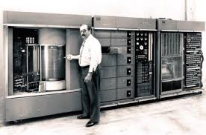
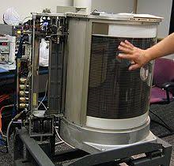
Brief Look at the Evolution of OS
1960s: Disks become mainstream
The first disk drive, the IBM 350 disk storage unit, was introduced in 1956. It had a capacity of 3.75 megabytes stored as five million six-bit characters on fifty (!) 24-inch diameter disks.
IBM leased it for $3,200 per month.
By the 1960’s disk storage finally comes into widespread use. It offers high capacity, almost-random-access-storage.
IBM created a family of Disk Operating Systems (DOS, DOS–2314, DOS MP, DOS VS, DOS/VSE) to take advantage of this technology.
Notes:
Random access high-capacity storage
The first disk drive, the IBM 350 disk storage unit, was introduced in 1956. It had a capacity of 3.75 megabytes stored as five million six-bit characters on fifty (!) 24-inch diameter disks. IBM leased it for $3,200 per month.
By the 1960’s disk storage finally comes into widespread use. It offers high capacity, almost-random-access-storage. IBM created a family of Disk Operating Systems (DOS, DOS–2314, DOS MP, DOS VS, DOS/VSE) to take advantage of this technology.

Slide 7
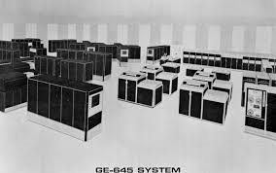
The OS Evolution
OS Complexity
BINAC
ENIAC
UNIVAC
IBM 701
UNIVAC 1103A
FORTRAN
IBM 7090
Burroughs B5000
DEC PDP-1
IBM System/360
GE-645 Mainframe
EDSAC and EDVAC
Transistor
1940
1950
1960
1970
1980
1990
2000
2010
2020
Notes:
Robert Jensen

Slide 8
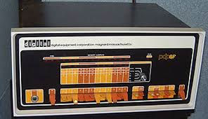
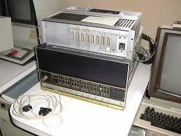
The OS Evolution
OS Complexity
BINAC
ENIAC
UNIVAC
IBM 701
UNIVAC 1103A
FORTRAN
IBM 7090
Burroughs B5000
DEC PDP-1
IBM System/360
GE-645 Mainframe
DEC PD-8
EDSAC and EDVAC
Transistor
1940
1950
1960
1970
1980
1990
2000
2010
2020
Notes:
Connor Bunch

Slide 9
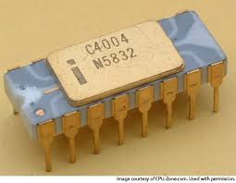
The OS Evolution
OS Complexity
BINAC
ENIAC
UNIVAC
IBM 701
UNIVAC 1103A
FORTRAN
IBM 7090
Burroughs B5000
DEC PDP-1
IBM System/360
GE-645 Mainframe
DEC PD-8
Intel 4004
EDSAC and EDVAC
Transistor
1940
1950
1960
1970
1980
1990
2000
2010
2020

Slide 10
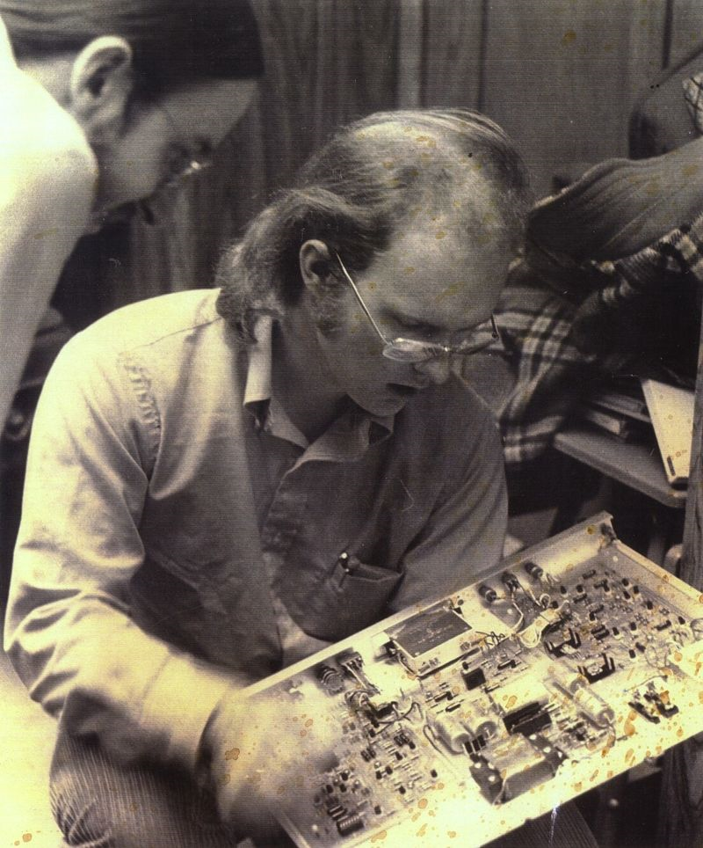
The OS Evolution
OS Complexity
BINAC
ENIAC
UNIVAC
IBM 701
UNIVAC 1103A
FORTRAN
IBM 7090
Burroughs B5000
DEC PDP-1
IBM System/360
GE-645 Mainframe
DEC PD-8
Intel 4004
Ethernet, WYSIWYG, Mouse
EDSAC and EDVAC
Transistor
1940
1950
1960
1970
1980
1990
2000
2010
2020
Notes:
Andrew Werner

Slide 11
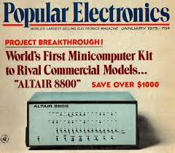
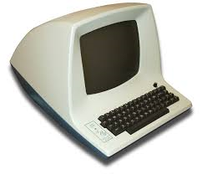
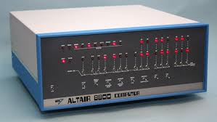
The OS Evolution
OS Complexity
BINAC
ENIAC
UNIVAC
IBM 701
UNIVAC 1103A
FORTRAN
IBM 7090
Burroughs B5000
DEC PDP-1
IBM System/360
GE-645 Mainframe
DEC PD-8
Intel 4004
Ethernet, WYSIWYG, Mouse
EDSAC and EDVAC
Altair 8800
Transistor
1940
1950
1960
1970
1980
1990
2000
2010
2020
Notes:
Zed Jensen

Slide 12
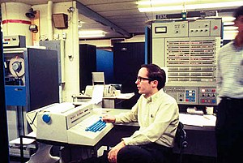
The OS Evolution
OS Complexity
BINAC
IBM System/360 Model 67
ENIAC
UNIVAC
IBM 701
UNIVAC 1103A
FORTRAN
IBM 7090
Burroughs B5000
DEC PDP-1
IBM System/360
GE-645 Mainframe
DEC PD-8
Intel 4004
Ethernet, WYSIWYG, Mouse
EDSAC and EDVAC
Altair 8800
Transistor
1940
1950
1960
1970
1980
1990
2000
2010
2020
Notes:
Isaac Draper

Slide 13
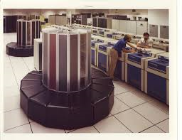
The OS Evolution
OS Complexity
BINAC
IBM System/360 Model 67
ENIAC
UNIVAC
IBM 701
UNIVAC 1103A
FORTRAN
IBM 7090
Burroughs B5000
DEC PDP-1
IBM System/360
GE-645 Mainframe
DEC PD-8
Intel 4004
Ethernet, WYSIWYG, Mouse
Altair 8800
EDSAC and EDVAC
CRAY-1
Transistor
1940
1950
1960
1970
1980
1990
2000
2010
2020
Notes:
Taylor Whitlock

Slide 14
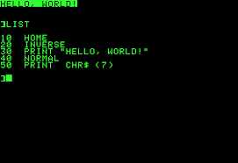
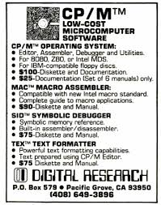
The OS Evolution
OS Complexity
BINAC
IBM System/360 Model 67
ENIAC
UNIVAC
IBM 701
UNIVAC 1103A
FORTRAN
IBM 7090
Burroughs B5000
DEC PDP-1
IBM System/360
GE-645 Mainframe
DEC PD-8
Intel 4004
Ethernet, WYSIWYG, Mouse
Altair 8800
CRAY-1
EDSAC and EDVAC
BASIC, CP/M
Transistor
1940
1950
1960
1970
1980
1990
2000
2010
2020
Notes:
Adam Warnick

Slide 15
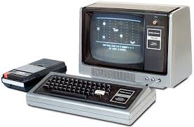
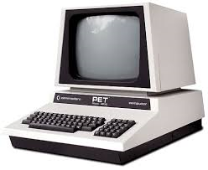
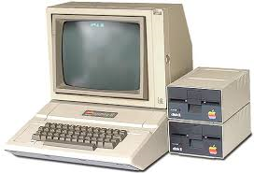
The OS Evolution
OS Complexity
BINAC
IBM System/360 Model 67
ENIAC
UNIVAC
IBM 701
UNIVAC 1103A
FORTRAN
IBM 7090
Burroughs B5000
DEC PDP-1
IBM System/360
GE-645 Mainframe
DEC PD-8
Intel 4004
Ethernet, WYSIWYG, Mouse
Altair 8800
CRAY-1
BASIC, CP/M
EDSAC and EDVAC
Apple II, PET, Atari
Transistor
1940
1950
1960
1970
1980
1990
2000
2010
2020
Notes:
Christian Rosenvall

Slide 16
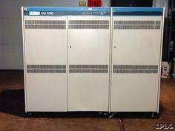
The OS Evolution
OS Complexity
IBM System/360 Model 67
BINAC
IBM System/360 Model 67
BINAC
ENIAC
ENIAC
UNIVAC
UNIVAC
IBM 701
IBM 701
UNIVAC 1103A
UNIVAC 1103A
FORTRAN
FORTRAN
IBM 7090
IBM 7090
Burroughs B5000
Burroughs B5000
DEC PDP-1
DEC PDP-1
IBM System/360
IBM System/360
GE-645 Mainframe
GE-645 Mainframe
DEC PD-8
DEC PD-8
Intel 4004
Intel 4004
Ethernet, WYSIWYG, Mouse
Ethernet, WYSIWYG, Mouse
Altair 8800
Altair 8800
CRAY-1
CRAY-1
BASIC, CP/M
BASIC, CP/M
Apple II, PET, Atari
EDSAC and EDVAC
DEC VAX 11/780
EDSAC and EDVAC
Transistor
Transistor
1940
1950
1960
1970
1980
1990
2000
2010
2020
Notes:
Michael Black

Slide 17
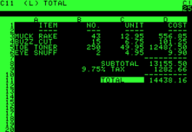
The OS Evolution
OS Complexity
BINAC
IBM System/360 Model 67
ENIAC
UNIVAC
IBM 701
UNIVAC 1103A
FORTRAN
IBM 7090
Burroughs B5000
DEC PDP-1
IBM System/360
GE-645 Mainframe
DEC PD-8
Intel 4004
Ethernet, WYSIWYG, Mouse
Altair 8800
CRAY-1
BASIC, CP/M
Apple II, PET, Atari
DEC VAX 11/780
EDSAC and EDVAC
Visicalc, WordStar
Transistor
1940
1950
1960
1970
1980
1990
2000
2010
2020
Notes:
Daniel Hancock

Slide 18
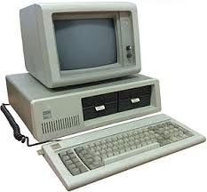
The OS Evolution
OS Complexity
BINAC
IBM System/360 Model 67
ENIAC
UNIVAC
IBM 701
UNIVAC 1103A
FORTRAN
IBM 7090
Burroughs B5000
DEC PDP-1
IBM System/360
GE-645 Mainframe
DEC PD-8
Intel 4004
Ethernet, WYSIWYG, Mouse
Altair 8800
CRAY-1
BASIC, CP/M
Apple II, PET, Atari
DEC VAX 11/780
Visicalc, WordStar
EDSAC and EDVAC
IBM PC
Transistor
1940
1950
1960
1970
1980
1990
2000
2010
2020
Notes:
Austin Clarke

Slide 19
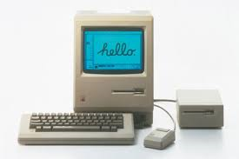
The OS Evolution
OS Complexity
BINAC
IBM System/360 Model 67
ENIAC
UNIVAC
IBM 701
UNIVAC 1103A
FORTRAN
IBM 7090
Burroughs B5000
DEC PDP-1
IBM System/360
GE-645 Mainframe
DEC PD-8
Intel 4004
Ethernet, WYSIWYG, Mouse
Altair 8800
CRAY-1
BASIC, CP/M
Apple II, PET, Atari
DEC VAX 11/780
Visicalc, WordStar
IBM PC
EDSAC and EDVAC
Apple Macintosh
Transistor
1940
1950
1960
1970
1980
1990
2000
2010
2020
Notes:
Jacob Bastian

Slide 20
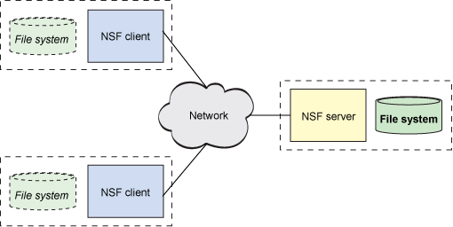
The OS Evolution
OS Complexity
BINAC
IBM System/360 Model 67
ENIAC
UNIVAC
IBM 701
UNIVAC 1103A
FORTRAN
IBM 7090
Burroughs B5000
DEC PDP-1
IBM System/360
GE-645 Mainframe
DEC PD-8
Intel 4004
Ethernet, WYSIWYG, Mouse
Altair 8800
CRAY-1
BASIC, CP/M
Apple II, PET, Atari
DEC VAX 11/780
Visicalc, WordStar
IBM PC
Apple Macintosh
EDSAC and EDVAC
SUN NFS
Transistor
1940
1950
1960
1970
1980
1990
2000
2010
2020
Notes:
Michael Sederberg

Slide 21
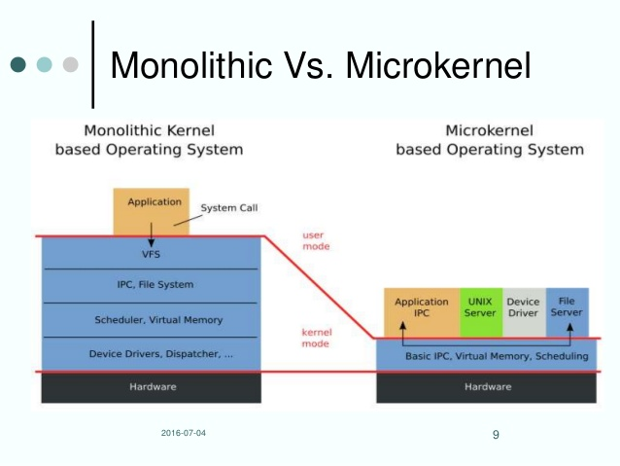
The OS Evolution
OS Complexity
BINAC
IBM System/360 Model 67
ENIAC
UNIVAC
IBM 701
UNIVAC 1103A
FORTRAN
IBM 7090
Burroughs B5000
DEC PDP-1
IBM System/360
GE-645 Mainframe
DEC PD-8
Intel 4004
Ethernet, WYSIWYG, Mouse
Altair 8800
CRAY-1
BASIC, CP/M
Apple II, PET, Atari
DEC VAX 11/780
Visicalc, WordStar
IBM PC
Apple Macintosh
SUN NFS
EDSAC and EDVAC
MACH vs Amoeba
Transistor
1940
1950
1960
1970
1980
1990
2000
2010
2020
Notes:
Caleb Larsen

Slide 22
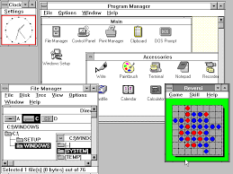
The OS Evolution
OS Complexity
BINAC
IBM System/360 Model 67
ENIAC
UNIVAC
IBM 701
UNIVAC 1103A
FORTRAN
IBM 7090
Burroughs B5000
DEC PDP-1
IBM System/360
GE-645 Mainframe
DEC PD-8
Intel 4004
Ethernet, WYSIWYG, Mouse
Altair 8800
CRAY-1
BASIC, CP/M
Apple II, PET, Atari
DEC VAX 11/780
Visicalc, WordStar
IBM PC
Apple Macintosh
SUN NFS
MACH vs Amoeba
EDSAC and EDVAC
Windows 3.0
Transistor
1940
1950
1960
1970
1980
1990
2000
2010
2020
Notes:
Caleb Gregory

Slide 23

The OS Evolution
OS Complexity
BINAC
IBM System/360 Model 67
ENIAC
UNIVAC
IBM 701
UNIVAC 1103A
FORTRAN
IBM 7090
Burroughs B5000
DEC PDP-1
IBM System/360
GE-645 Mainframe
DEC PD-8
Intel 4004
Ethernet, WYSIWYG, Mouse
Altair 8800
CRAY-1
BASIC, CP/M
Apple II, PET, Atari
DEC VAX 11/780
Visicalc, WordStar
IBM PC
Apple Macintosh
SUN NFS
MACH vs Amoeba
Windows 3.0
EDSAC and EDVAC
GNU / Linux
Transistor
1940
1950
1960
1970
1980
1990
2000
2010
2020
Notes:
Trevor Jex

Slide 24
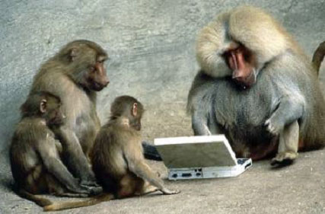

Be Safe

